Slide 2
Aggregation Framework
Un motor analítico nativo para MongoDB
Pero… que significa analítico?
Si miramos a las BBDD clásicas tenemos dos tipos, OLTP y OLAP
OLTP : Online Transaction Processing
Reservas de aviones
Operativa de cajeros
Gestión de clientes(CRM)
OLAP : Online Analytical Processing
Cálculos de rentabilidad y Overbooking
Predicción de demanda y optimización y de recargasd e cajerois
Segmentación de clientes

Slide 3
Agg. Frmwk – Pipeline
Match
Project
Lookup
Group
Sort
Similar a unix pipeline
La salida de una etapa es pasada a la entrada de la siguiente etapa
Cada etapa realiza un trabajo
Se pueden repetir las etapas
La entrada es una coleccion

Slide 4
Pipeline Operators
• $match
Filtra documentos
• $project/$redact
Reformula documentos
• $group
Agrupa documentos
• $out
Crea nuevas colecciones
• $sample
Retorna valores aleatorios
• $sort
Ordena documentos
• $limit/$skip
Pagina documentos
• $lookup
Agrupa colecciones
• $unwind
Desarma un array
• $geoNear
Retorna documentos ordenados por distancia

Slide 5
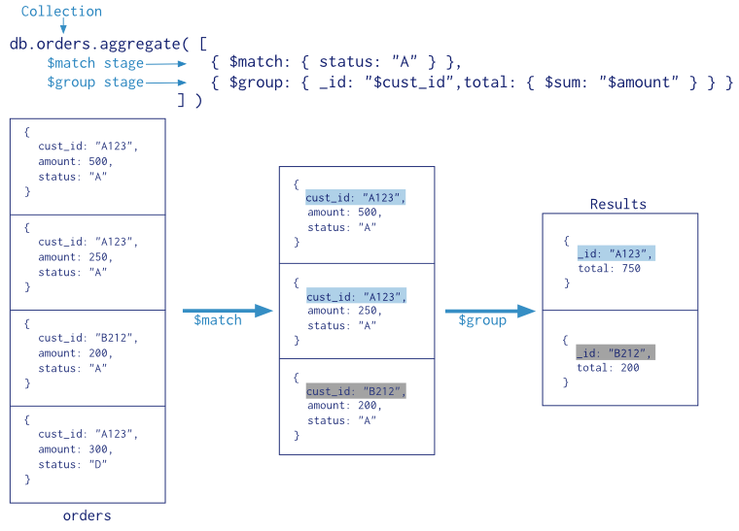

Slide 6
SQL | MongoDB
WHERE | $match
GROUP BY | $group
HAVING | $match
SELECT | $project
ORDER BY | $sort
LIMIT | $limit
SUM() | $sum
COUNT() | $sum
join | $lookup

Slide 7
Documento ship
{ "_id" : ObjectId("56fda36a0a162d0f051f2c6d"),
"Built" : 2015,
"Name" : "MSC Zoe",
"Length overall (m)" : 395.4,
"Beam (m)" : 59,
"Maximum TEU" : 19224,
"GT" : 193000,
"Owner" : "MSC",
"Country" : "Switzerland",
"route" : {
"origin" : {
"Name" : "Tianjin",
"Country" : "China”},
"destination" : {
"Name" : "Shanghai",
"Country" : "China”}},
"location" : {
"type" : "Point",
"coordinates" : [
129.15693498213182, 18.108558232731916]},
"EAT" : ISODate("2016-05-16T10:00:00Z”)}

Slide 8
Documento container
{
"_id" : ObjectId("5719290546728347c6fbdc4c"),
"container_id" : "00000001",
"type" : "40",
"cargo" : "Whales",
"Tons" : 38,
"location" : {
"type" : "Point",
"coordinates" : [
129.15297142372992,
18.108451503053704
]
},
"shipName" : "MSC Zoe"
}

Slide 9
$limit
MongoDB Enterprise > db.ships.aggregate([{$limit : 2}])
{ "_id" : ObjectId("56fda36a0a162d0f051f2c6d"), "Built" : 2015, "Name" : "MSC Zoe", "Length overall (m)" : 395.4, "Beam (m)" : 59, "Maximum TEU" : 19224, "GT" : 193000, "Owner" : "MSC", "Country" : "Switzerland", "route" : { "origin" : { "Name" : "Tianjin", "Country" : "China" }, "destination" : { "Name" : "Shanghai", "Country" : "China" } }, "location" : { "type" : "Point", "coordinates" : [ 129.15693498213182, 18.108558232731916 ] }, "EAT" : ISODate("2016-05-16T10:00:00Z") }
{ "_id" : ObjectId("56fda36a0a162d0f051f2c70"), "Built" : 2015, "Name" : "MSC Oscar", "Length overall (m)" : 395.4, "Beam (m)" : 59, "Maximum TEU" : 19224, "GT" : 192237, "Owner" : "MSC", "Country" : "Switzerland", "route" : { "origin" : { "Name" : "Kaohsiung", "Country" : "Taiwan" }, "destination" : { "Name" : "Shanghai", "Country" : "China" } }, "location" : { "type" : "Point", "coordinates" : [ 153.87348512279215, 44.683039336234614 ] }, "EAT" : ISODate("2016-05-25T09:00:00Z") }
MongoDB Enterprise >

Slide 10
$skip
MongoDB Enterprise > db.ships.aggregate([{$limit : 7}, {$skip: 5}])
{ "_id" : ObjectId("56fda36a0a162d0f051f2c72"), "Built" : 2014, "Name" : "CSCL Pacific Ocean", "Length overall (m)" : 399.67, "Beam (m)" : 58.6, "Maximum TEU" : 19100, "GT" : 187541, "Owner" : "CSCL", "Country" : "China", "route" : { "origin" : { "Name" : "Ningbo-Zhoushan", "Country" : "China" }, "destination" : { "Name" : "Kaohsiung", "Country" : "Taiwan" } }, "location" : { "type" : "Point", "coordinates" : [ -168.88031791679694, 41.72272856411992 ] }, "EAT" : ISODate("2016-05-24T04:00:00Z") }
{ "_id" : ObjectId("56fda36a0a162d0f051f2c73"), "Built" : 2015, "Name" : "CSCL Indian Ocean", "Length overall (m)" : 399.67, "Beam (m)" : 58.6, "Maximum TEU" : 19100, "GT" : 187541, "Owner" : "CSCL", "Country" : "China", "route" : { "origin" : { "Name" : "Jebel Ali (Dubai)", "Country" : "United Arab Emirates" }, "destination" : { "Name" : "Ho Chi Minh City (Saigon)", "Country" : "Vietnam" } }, "location" : { "type" : "Point", "coordinates" : [ -136.48534585524587, 27.322294568378965 ] }, "EAT" : ISODate("2016-05-27T12:00:00Z") }
MongoDB Enterprise >

Slide 11
$sample
{$sample: {size : 10}}

Slide 12
$match
MongoDB Enterprise > db.ships.aggregate([{$match :{"Country": "China"}}])
MongoDB Enterprise > db.ships.aggregate([{$match :{"route.origin.Country": "China"}}])
MongoDB Enterprise > db.ships.aggregate([{$match : {location: {$geoWithin: {$geometry : caribe.geometry}}}}])

Slide 13
$geoNear
db.ships.aggregate([
{
$geoNear: {
near: { type: "Point", coordinates: [ -122.4252, 37.8283 ] },
distanceField: "dist.calculated",
maxDistance: 3000000,
distanceMultiplier: 0.001,
query: { cargo: "Iron" },
limit : 1000000,
includeLocs: "dist.location",
spherical: true
}
}])

Slide 14
$lookup
{$lookup : {from: "containers", as: "cargo", localField: "Name", foreignField: "shipName"}}

Slide 15
$unwind
{$unwind: "$cargo"}

Slide 16
$group
{$group : {_id: {ship: "$Name", cargo : "$cargo.cargo", route: "$route", location: "$location"}, sum: {$sum: "$cargo.Tons"}}}

Slide 17
$project
var project = {$project: {_id : {ship: "$_id.ship", route: "$_id.route", location: "$_id.location"}, cargo : {type : "$_id.cargo", Tons: "$sum"}}}

Slide 18
$out
{$out : "ships2"}

Slide 19
Summary
Pipeline de operaciones
Select, project, group, sort, lookup
$out debe ir en ultimo lugar
Hay muchos tipos de operadores
Una forma muy poderosa de reformar y analizar datos
Obtiene gran performance en grandes volumenes de datos

